Slide 1

Project Objective & Overview
Objective: Build and tune machine learning models to predict house sale prices based on property features (e.g. location, house type, condition).
Context: Used a historical housing dataset (features like neighborhood, property type, condition, etc.) to train models that estimate a house’s market price. The goal is to achieve accurate predictions to assist in valuation.

Slide 2

Machine Learning Workflow
Data Preprocessing: Cleaned data and handled missing values. Encoded categorical features and scaled numeric features for uniform range.
Feature Engineering: Created/improved features where possible Ensured all features are relevant and informative for price prediction.
Model Selection: Tried multiple regression algorithms – Linear Regression, Decision Tree, Random Forest, XGBoost – to compare performance. Used a training/validation split and cross-validation to fairly evaluate each model.
Hyperparameter Tuning: Performed Grid Search / Randomized Search with cross-validation for key models (especially Random Forest & XGBoost) to find optimal settings (e.g. tree depth, learning rate, etc.).
Model Evaluation: Assessed models on a hold-out validation set using metrics RMSE (Root Mean Squared Error), MAE (Mean Absolute Error), and R² (coefficient of determination). This end-to-end pipeline (preprocessing → modeling → evaluation) ensured reliable performance estimates.

Slide 3

Model Evaluation & Results
Evaluated each model’s accuracy using 5-fold cross-validation and computed key metrics (lower RMSE/MAE and higher R² are better):
Performance Comparison: The table below summarizes validation results for the models tested. Tuned models (Random Forest and XGBoost with optimized hyperparameters) showed significant improvement in prediction accuracy.
Model | RMSE | MAE | R2
XGBoost | 71066.752811 | 33205.092521 | 0.931205
Random Forest | 86408.857850 | 28173.138858 | 0.898295
ExtraTreesRegressor | 89705.040790 | 33360.109530 | 0.890387
Ridge/Lasso Regression | 170480.489028 | 109075.948380 | 0.604108
Linear Regression | 170553.613213 | 109095.155286 | 0.603769
Support Vector Regressor | 275198.974802 | 186455.771427 | -0.031622
Best Model: The tuned XGBoost model achieved the lowest error (RMSE ~ $28K) and highest R² (~0.93), indicating it explains ~93% of the variance in house prices. The tuned Random Forest was the next best, close behind XGBoost. Both significantly outperformed simpler models like Linear Regression or a single Decision Tree.

Slide 4
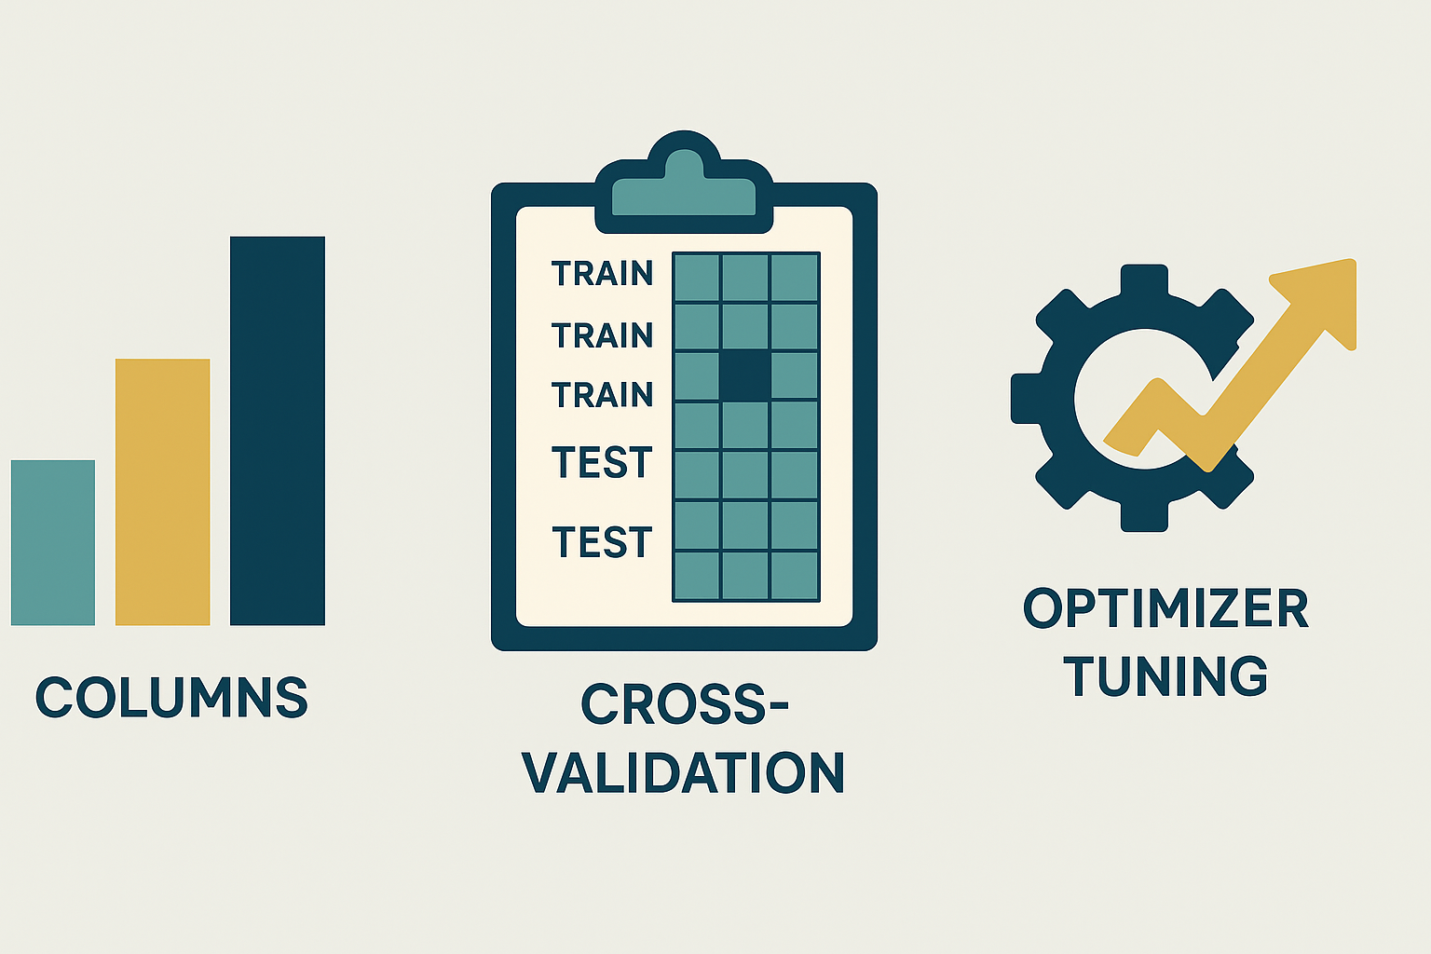
Stretch Goals – Pipeline & Data Leakage Prevention
Pipeline Implementation: Developed a Scikit-Learn Pipeline to streamline the workflow. The pipeline combined preprocessing steps (e.g. imputation, encoding, scaling) with the model into a single integrated process. This makes the workflow clean, reproducible, and easier to apply consistently to any new data (e.g. on a test set or in production).
GridSearchCV with Scikit-Learn Pipelines: We used GridSearchCV along with pipelines to tune hyperparameters for models like Random Forest and XGBoost. Although we relied on default Scikit-learn methods, the separation between train and test data was maintained throughout.
Model Pipeline for Deployment: We wrapped preprocessing and model training steps into a single pipeline using Scikit-learn’s Pipeline object. This ensures that future predictions (on unseen data) go through the exact same transformation steps, avoiding any inconsistencies or leakage risks.

Slide 5

Conclusion & Key Takeaways
Objective Achieved: Successfully built and tuned multiple models to accurately predict housing prices. The best model (tuned XGBoost) can predict prices with high accuracy (e.g. ~93% R² on validation data).
Model Performance: Ensemble tree-based models proved most effective – XGBoost slightly outperformed Random Forest after hyperparameter tuning. These models captured complex non-linear relationships in the housing data, yielding much lower error than baseline models.
Workflow Rigor: A well-defined ML pipeline and rigorous cross-validation were critical. They ensured our evaluation was unbiased and that the model will generalize well to new data. In particular, addressing data leakage by fitting preprocessing only on training data safeguards the integrity of our results.
Next Steps: With this solid foundation, the model could be further improved by exploring additional features (e.g by stacking/ensembling multiple models). The current results and pipeline provide a strong baseline for deploying a reliable house price prediction tool.

